Slide 1

Recycling the Web: Rust and WebAssembly for a cleaner, safer web ecosystem
Liviu-Alexandru Bobocu, Frontend Community LEAD, Endava

Slide 2

Agenda
JS ECOSYSTEM, a problem for SECURITY and PERFORMANCE
WHY RUST? A Short introduction
Why webassembly? AN introduction
Webassembly – TOOLS, Standards
Building an app with REACT, RUST and WASM
Q/A

Slide 3

1
A problem for security and performance
JS ecosystem

Slide 4

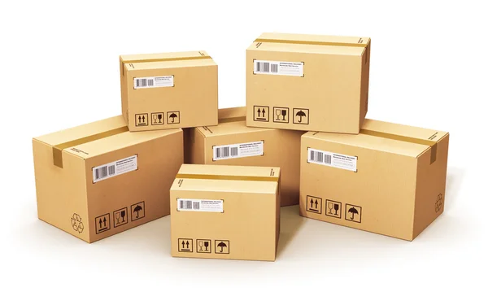

Slide 5


Slide 6

The packaging model is broken probably by design
Through time, various packages were affected by exploits that enabled malicious users gain access, control over assets.
How did exploits work? 1. Step 1 – The malicious user creates a useful piece of software that he will further use to exploit a larger system
2, Step 2 – The malicious user creates a package for this piece of software and submits it to NPM.
3. Step 3 – The next step is to actually submit a PR to the parent open source software for which the piece of software was intended ( At this stage the open source software is used at scale by a huge number of companies)
4. Step 4 – The PR is accepted, the code looks good and the dependency tree for the original open source software is changed, having a dependency on the code that the malicious user wrote. The user gained the keys to writing new bits of software.
6. Step 5 – The malicious user introduces a piece of code in that package that exploits the original system to gain access to critical information. He then bumps the version in the software.
7. Step 6 – The malicious user waits for a while, for companies that are using the software to actually make an update and include his dependency. Once updated, he gains control to critical resources and assets of users of the parent systems.
These kinds of attacks are increasing and we need to keep pace.
We have a responsibility of changing our web future

Slide 7


Poorly managed PACKAGES are increasing
We are introducing a large number of poorly managed and poorly tested packages from JavaScript ecosystems, with lots of technical debt and possible vulnerabilities.
The KEYS are given to everyone
The JS packaging model works by giving access to everyone and enables people to write software easy. However, without properly identifying the people responsible, we are potentially giving our house keys to harmful users.

Slide 8
2
A short introduction
Why Rust ?

Slide 9

Its mascot
Its compiler
Low level control
Memory model

Slide 10
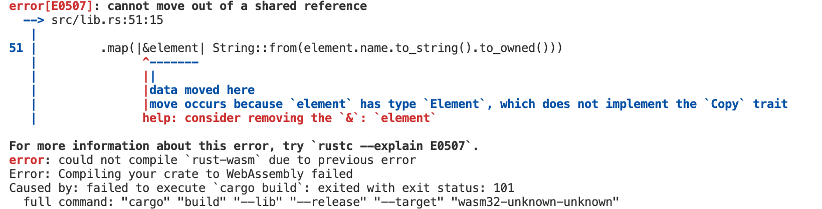
Its compiler

Slide 11
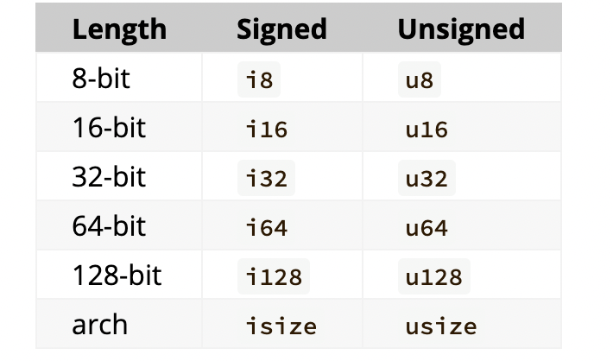
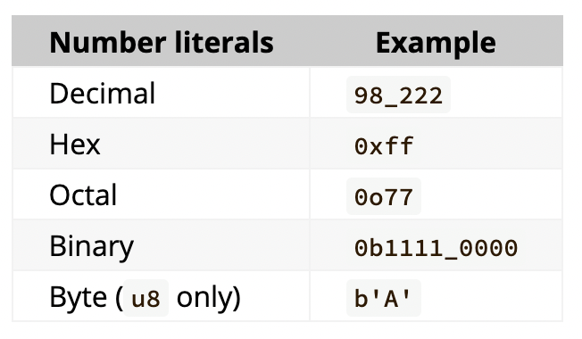
Low Level Control
Rust low level control starts from its types
Primitive types:
Boolean — bool
Numeric — integer and float
Textual — char and str
Never — ! — a type with no values
Sequence types:
Tuple
Array
Slice
User-defined types:
Struct
Enum
Union
Floating point values are represented by f32 and f64
Function types:
Functions
Closures
Pointer types:
References
Raw pointers
Function pointers
Trait types:
Trait objects
Impl trait

Slide 12

Low Level Control
Rust has no Garbage Collector by default.
You can use different crates (Rust packages) to employ a garbage collector, but it is not necessary.
Rust uses the ownership model and lifetimes to determine the lifetime of a variable at compile time.
As Rust has a strict compiler, its rules will prevent an immediate adoption from an unexperienced developer, steepening the learning curve.
As Rust targets variable lifetime from compile time, there is no garbage collector and most of the compiler rules will ensure safety when running the code, Rust has a minimal runtime and can easily be deployed over multiple types of machines.

Slide 13
3
An introduction
Why WebAssembly?

Slide 14

Low Level Assembly like language with a compact binary format that runs at near native performance
Good overall performance (slowed down by glue code when interoperating with JavaScript)
Security
Cross platform adoption

Slide 15
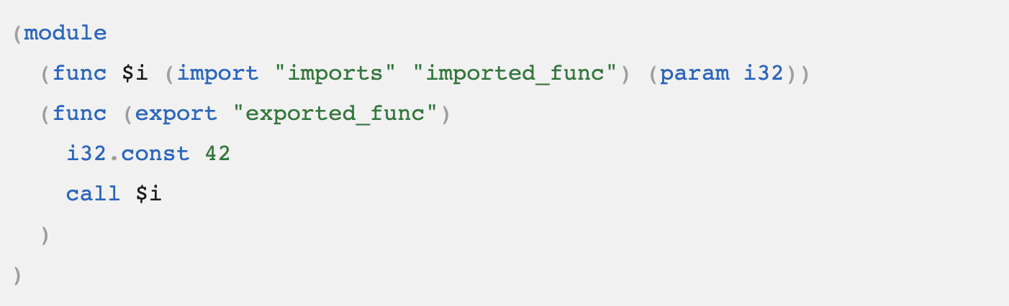
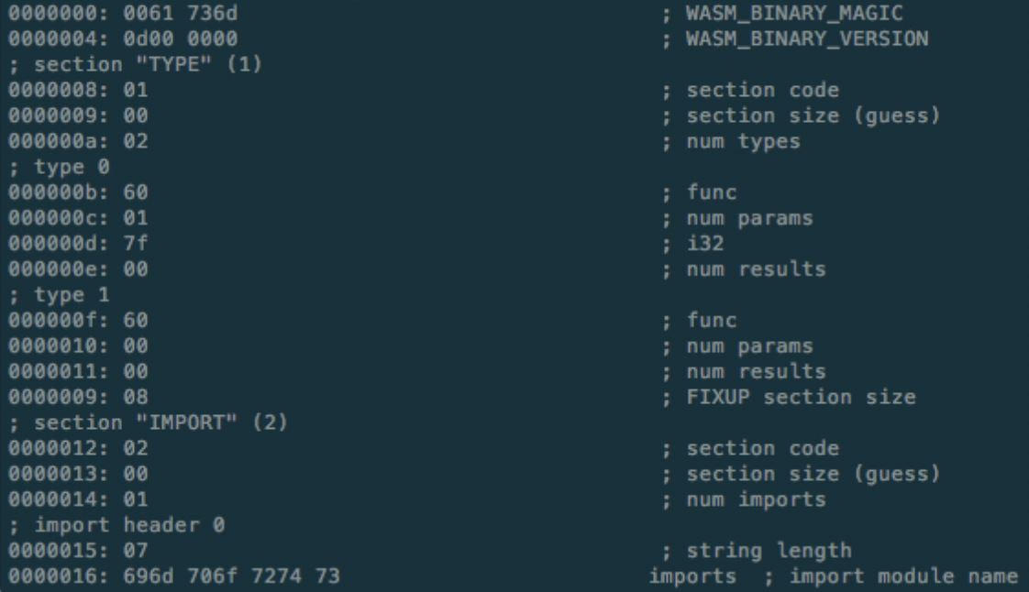
WebAssembly: WAT and WASM formats
WebAssembly has an intermediate text representation called WAT designed to be exposed to developers and a WASM assembly format, which will be the actual format run in the browser.

Slide 16
Good overall performance
WebAssembly itself is more performant than JavaScript for crunching numbers. Due to its type system which initially included numerical types (int32, int64, float32, float64), WebAssembly was primarily used in porting games and applications to the browser.
As it misses other types required to genuinely interoperate within the browser, like String for instance, glue code needs to be called and the operation itself ads a small overhead on the WebAssembly usage, eventually cancelling the benefit of performance in some occasions.
Currently, within this glue code there is a mapping between webassembly and JavaScript numerical types
WASM types to JS Types
Int32 -> Number (float64/double in JS)
Int64 -> BigInt (24 bytes on 64 bit systems)
Float32 -> Number (float64/ double in JS)
Float64 -> Number

Slide 17
WebAssembly Types
Number Types numtype ::= i32 | i64 | f32 | f64
Vector types vectype ::= v128 – vectors of numeric values processed by vector instructions (SIMD)
Reference types – first class references to runtime store
reftype ::= funcref | externref
Value Types - individual values
valuetype ::= numtype | vectype | reftype
Result types – result of executing instructions or functions
resulttype ::= [vec(valtype)]
Full list can be found in the docs

Slide 18

More performance – Interface types
The WebAssembly specification for Interface Types will allow WebAssembly to interoperate better with other programming languages and the browser itself.
By removing glue code and other unnecessary conversions, Web Assembly usage will be more performant.

Slide 19

Security
To quote the WebAssembly Standard
” The security model of WebAssembly has two important goals: (1) protect users from buggy or malicious modules, and (2) provide developers with useful primitives and mitigations for developing safe applications, within the constraints of (1).”
WebAssembly itself, it’s system interface (WASI), it’s main runtime environment (Wasmtime) are all developed by collaborating with academia and researchers to mitigate potential security flaws and vulnerabilities, eventually aiming for a portable and safe language across the web.

Slide 20
4
Runtime ENVIRONMENT, SYSTEM INTERFACE
WebAssembly Tools, Standards

Slide 21

WASI
WASI is short for Web Assembly System Interface.
It is a modular system interface containing a collection of APIs for WebAssembly to interact with the outside world.
The APIs are runtime independent. Each host environment selects which APIs are more suited for their use case.
WASI is built with capability based security principles.
Access to external resources is represented by handles (unforgeable values). You may not request a handle purely by providing a string or a user controlled identifier. (no ambient authorities)
The only way to obtain access to resources are given handles, or to perform operations on handles and return new ones.
WASI would solve our keys problem from the beginning. Interoperability between wasm modules would be granted to have enforced security as opposed to JavaScript ones.
.

Slide 22
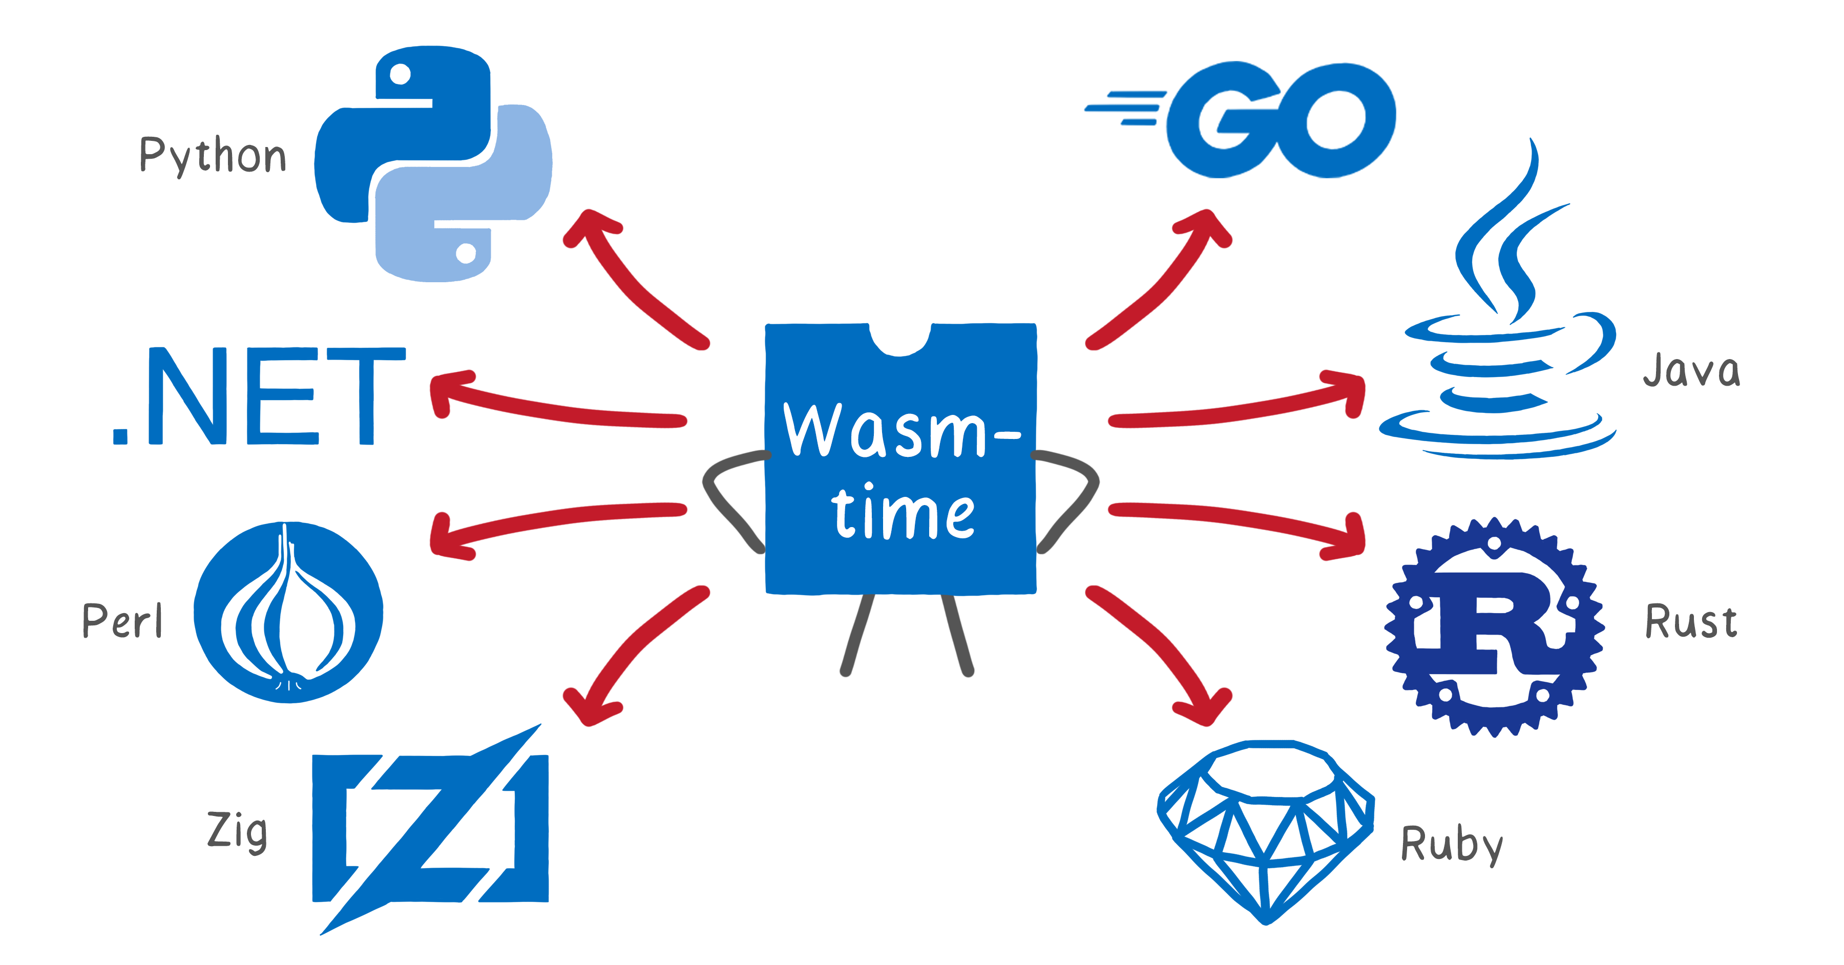
Wasmtime
Wasmtime is a standalone wasm-only optimizing runtime environment for WebAssembly.
It is designed to run WebAssembly code outside the web.
Wasmtime is focused on being state of the art secure and each feature is carefully considered and tested when deployed. The Wasmtime team works with academic reaserchers to ensure critical parts of the runtime.
It offers ways of debugging and profiling wasm outside the web.
It integrates with WASI.
Provides tools for other programming languages to interoperate with WebAssembly.

Slide 23
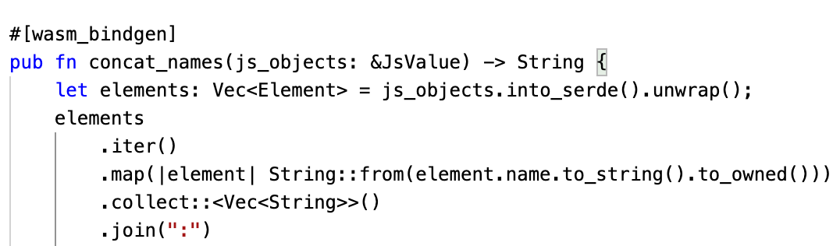
Wasm Bindgen
Wasm Bindgen is a tool that allows interoperability between JavaScript and Rust.
It creates glue code only for the functionalities that are used between languages.
It allows you to import WebAssembly modules as ECMAScript modules.
Rust methods are visible within the generated code for the browser. Designed with the proposal of Web IDL which is part of the Interface Types Spec.
Eventually, no glue code will be necessary, and you will be able to access DOM APIs directly from wasm, thus from Rust.
WebIDL Standard – interface definition language describing interfaces that will be implemented in web browsers

Slide 24

Wasm Pack
Wasm Pack is a tool for building web assembly packages from Rust and allows packages them to be interoperable with JavaScript applications.
Once built with wasm-pack, the wasm module is easily imported within a frontend framework like React, Svelte, etc.

Slide 25
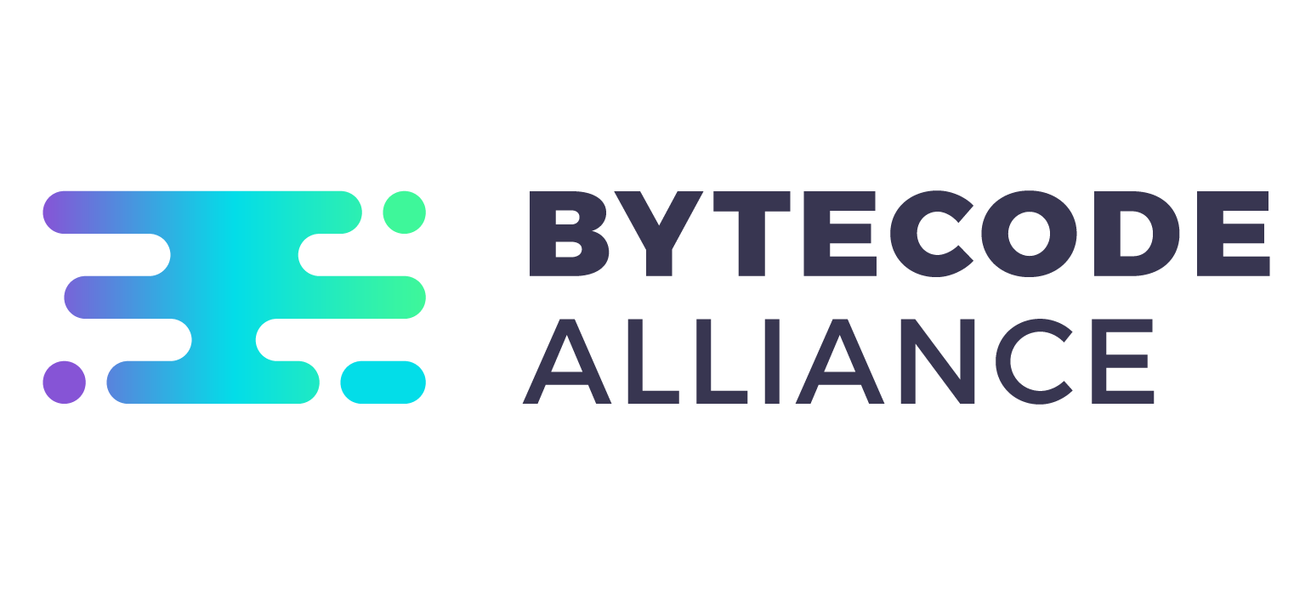
Behind the scenes – The Bytecode Alliance
The Bytecode Alliance is an NGO focused on building secure standards for WebAssembly and WASI. People from Mozilla, Intel, Fastly and many others are working together to secure the future of the web.

Slide 26
5
Building an app with REACT, RUST and WASM

Slide 27


It’s demo time!

Slide 28
5
Q/A
Notes:
Chapter Intro Slide (version O)
This slide should be used at the beginning of each “chapter” of your presentation (as introduced in the Agenda slide) to keep the audience aware of their place in the story and to help break things up. Change the text and chapter number accordingly. If you do not need a sub-head (the smaller text), delete it. Use different backgrounds for different chapter titles, try not to repeat a background.
Very short presentations (< ~10 slides) may not need Chapter Intro Slides.
There are multiple versions of this template with various white and black background images starting on slide 10.

Slide 29

Thank you for your time!
Slides and code can be found on Github at liviualexandrubobocu/devconf-rust-wasm
Liviu.bobocu@endava.com
+40725213995
Liviu-Alexandru Bobocu
Frontend Community Lead

